Slide 1
Autonomous Navigation System Using Sensor Fusion
Project work
Name: MD Rafiul Islam
Matriculation No: 1232714
Course: Electronic Engineering
Supervisor: Prof. Dr. Achim Rettberg
Second Supervisor: M. Sc. Ali Alhalabi

Slide 2
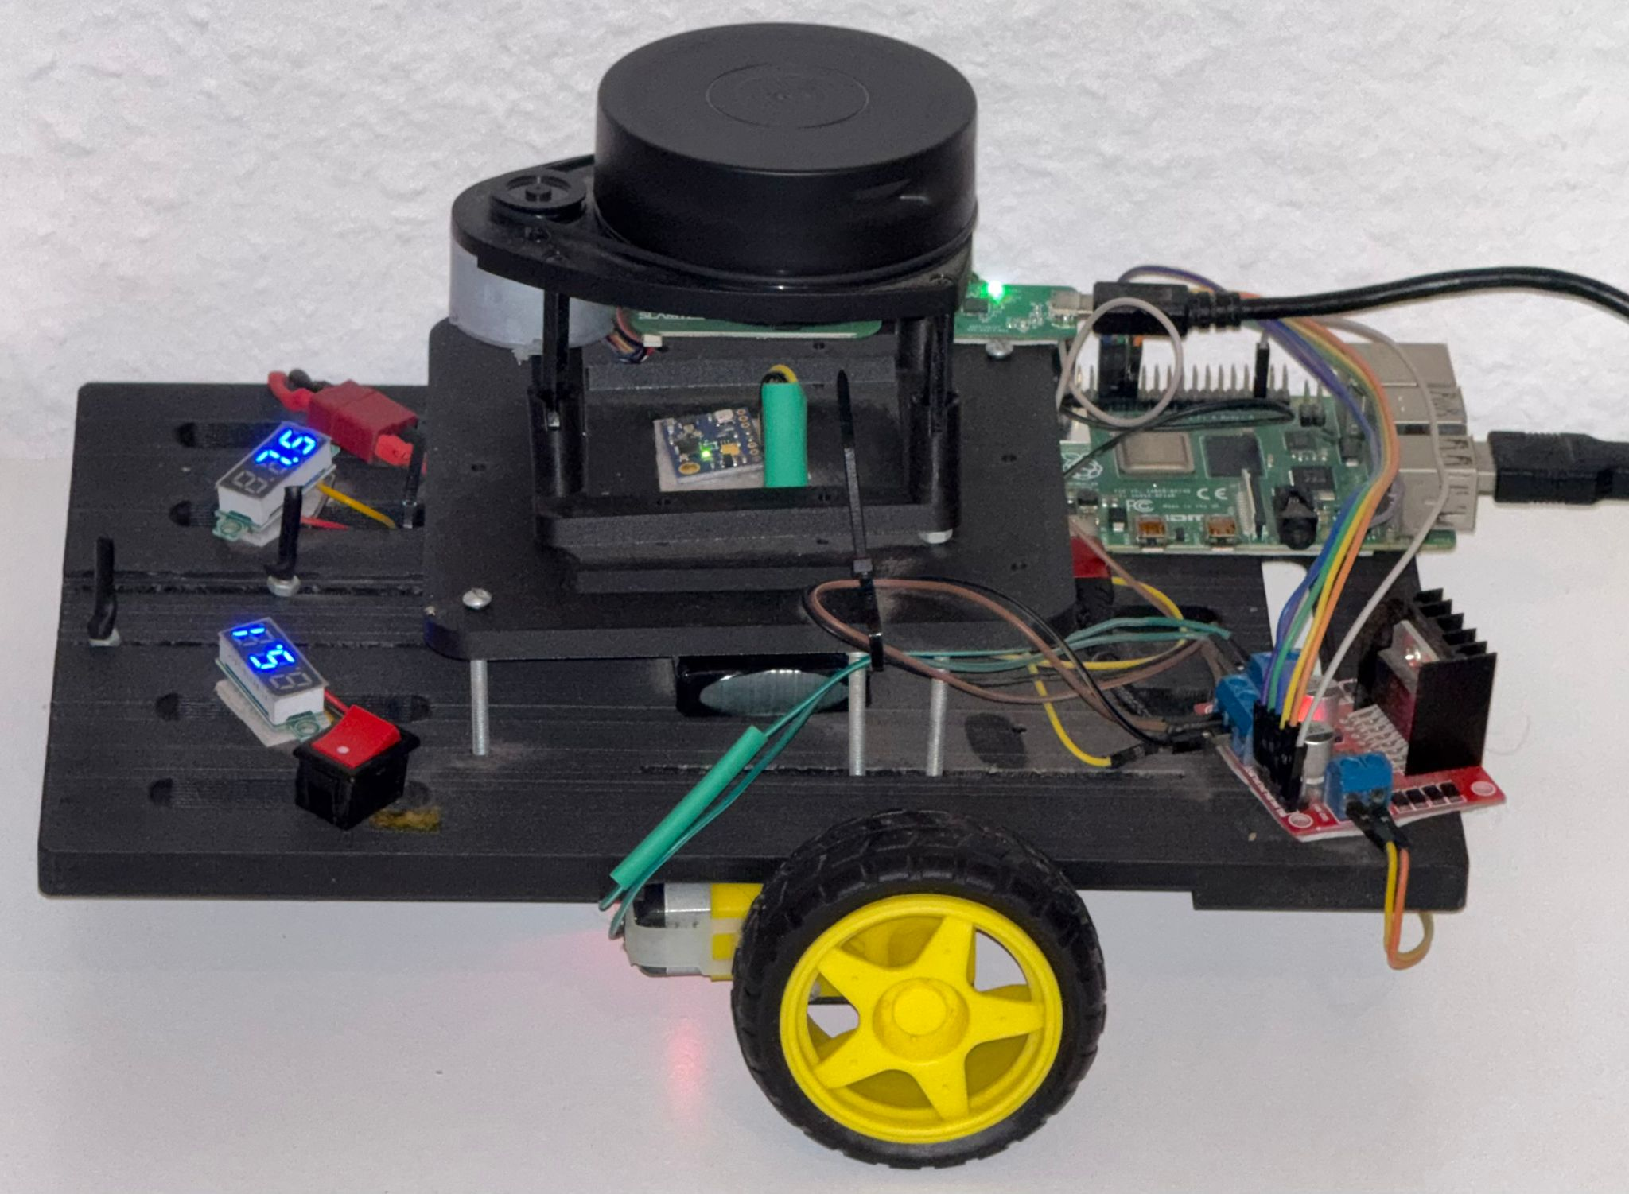
Motivation
Robots need accurate position and motion.
IMU, LiDAR, wheels, and GPS have limits.
Multiple sensors can give conflicting data.
Sensor fusion reduces individual sensor errors.
Fusion model gives a more reliable robot state.

Slide 3
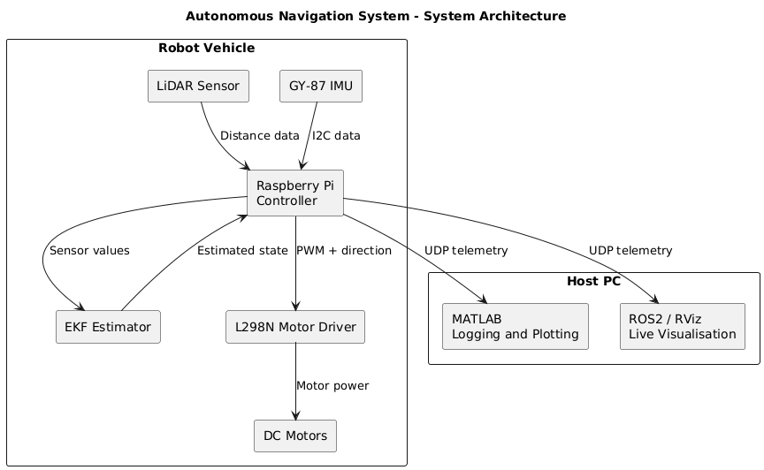
Autonomous Navigation System – Component Diagram

Slide 4
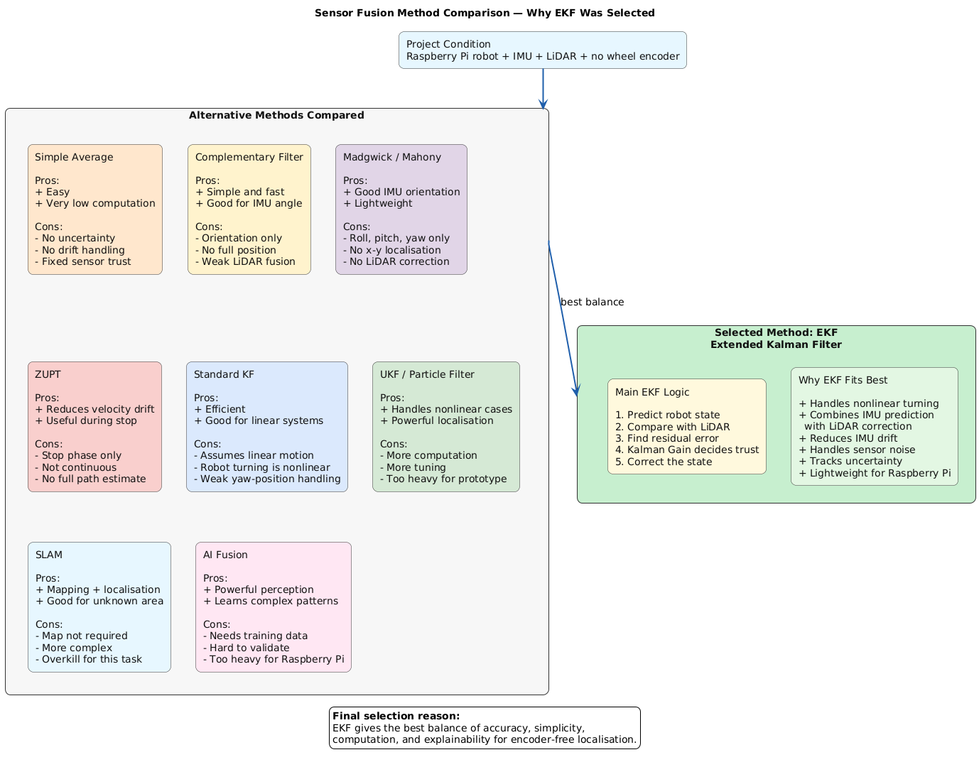
Types of Sensor Fusion Model:

Slide 5
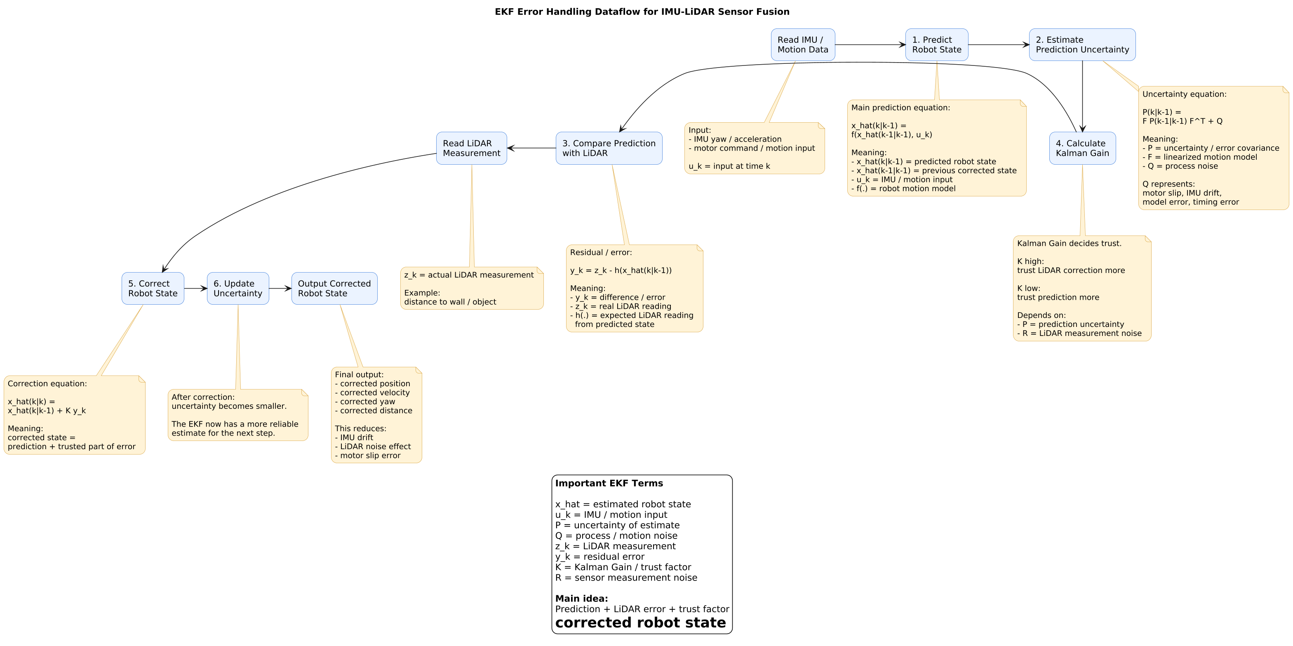
EKF Fusion Process

Slide 6
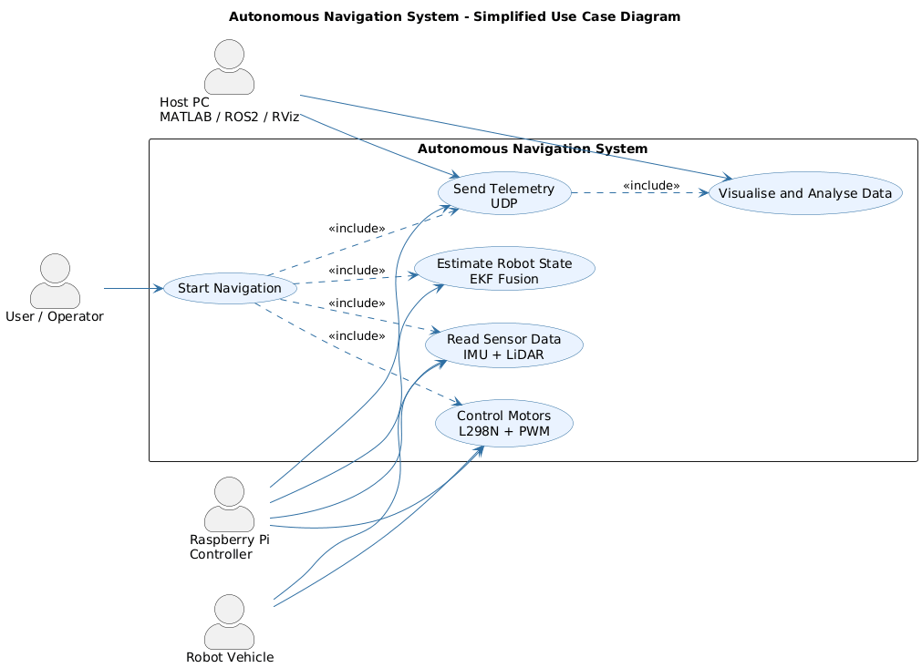
Autonomous Navigation System - Use Case Diagram

Slide 7
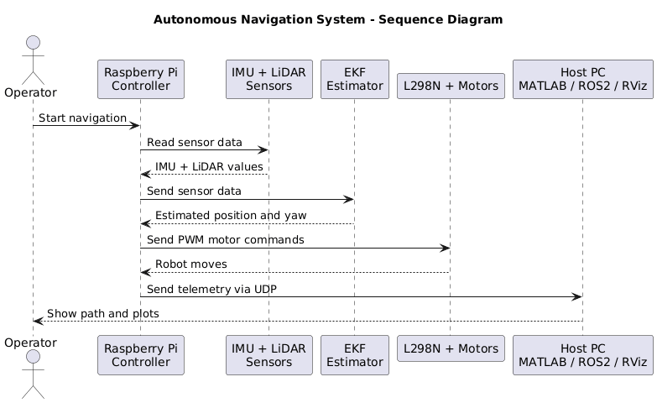
Autonomous Navigation System –Sequence Diagram

Slide 8
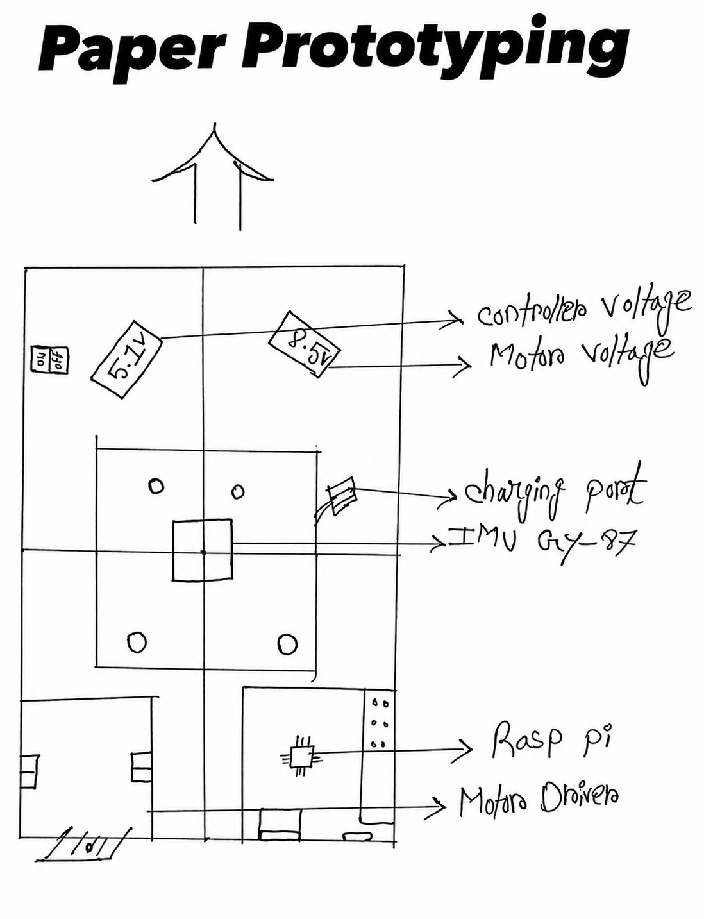
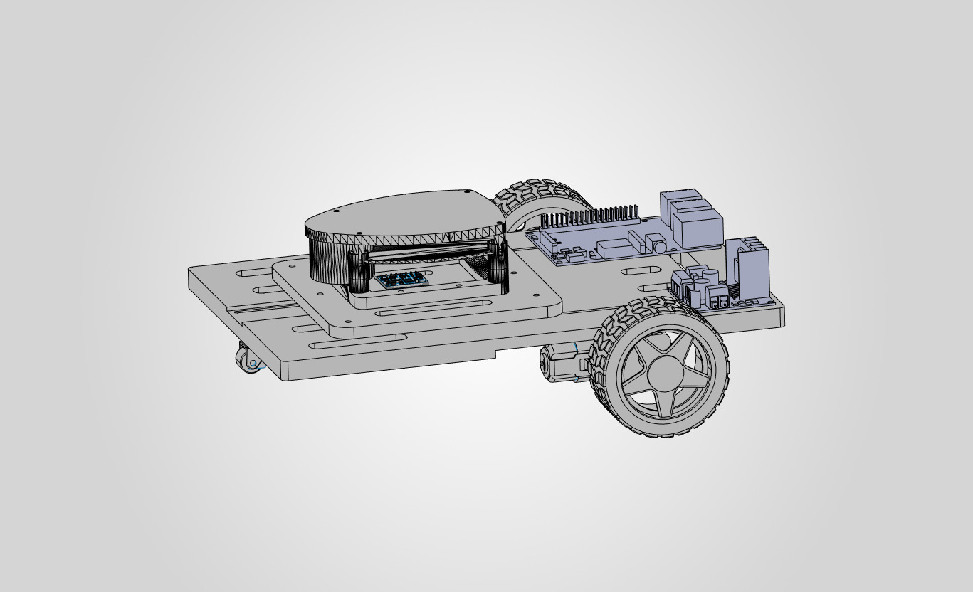
Mechanical Design: From Paper to Prototype
Paper prototype is initially sketched.
Developed full chassis in mechanical design tool focused on:
LiDAR positioned for clear 360° scanning.
IMU centered for accurate motion measurement.
Balanced wheel placement.
Weight distribution.

Slide 9
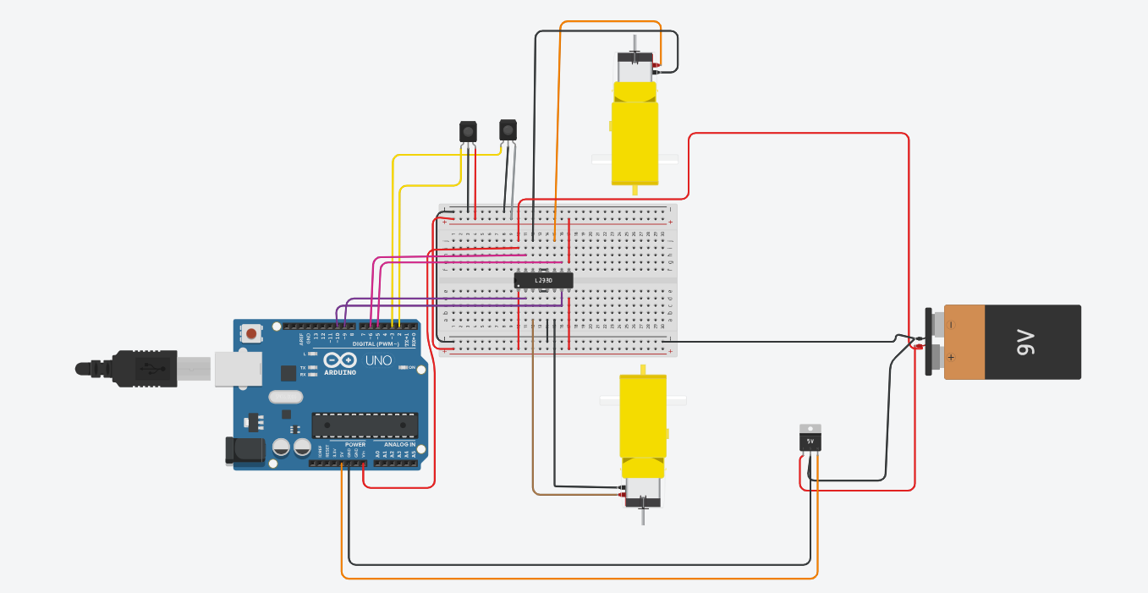
Electrical Design & Wiring
Raspberry Pi GPIO is connected to L298N (IN1–IN4 direction pins,ENA, ENB for PWM).
GY-87 is connected Pi via I²C .
LiDAR is connected Pi via UART.
Battery is connected to regulate voltage of Pi but motor rail directly from battery
Common ground across battery, L298N, regulator, Pi, sensors.

Slide 10
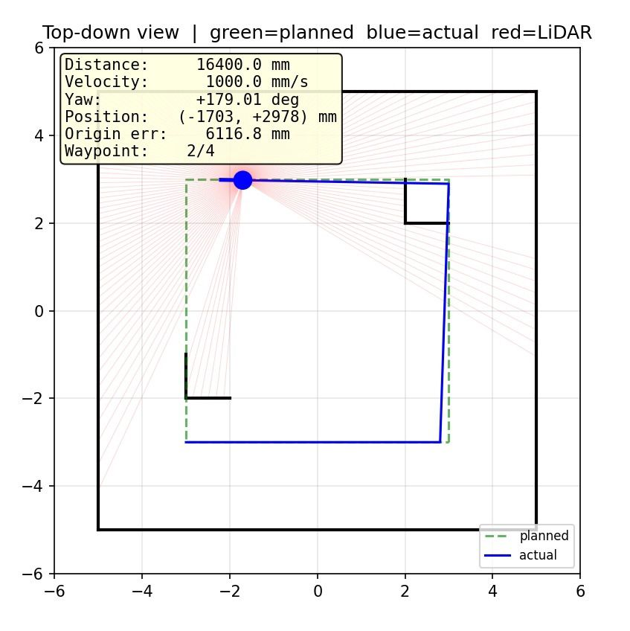
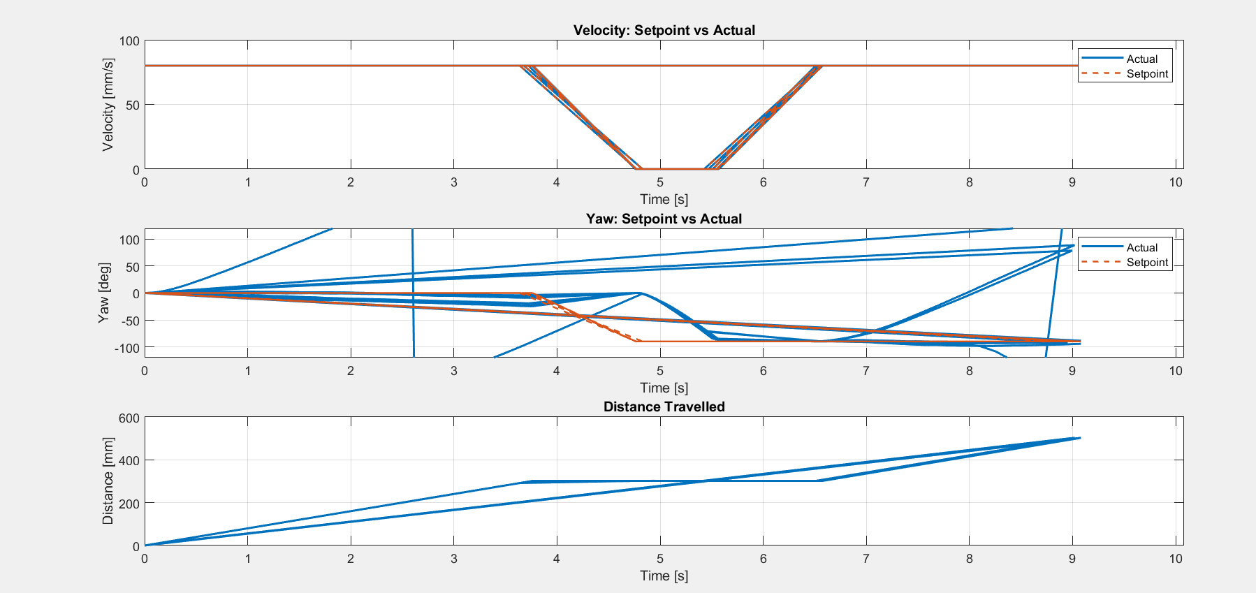
Without EKF: Real Vehicle and Simulation
Actual path drifts away from the planned path.
Yaw angle becomes unstable during turning.
Velocity does not follow the setpoint smoothly.
Distance estimation keeps accumulating error.
LiDAR/odometry alone cannot correct the robot position.

Slide 11
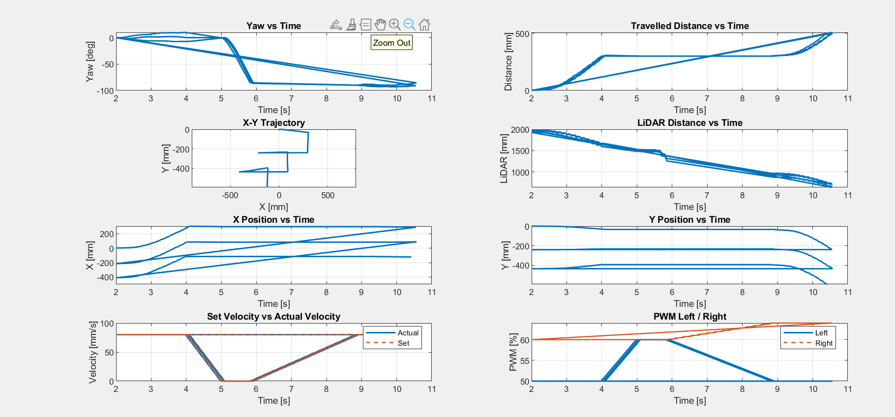
Applying EKF: Raspberry pi data using MATLAB plot
Raspberry Pi collects IMU and LiDAR data.
Python script runs EKF predict–correct estimation.
Sensor and EKF data are sent to MATLAB using UDP packets.
MATLAB logs the received data into CSV files.
MATLAB plots path, yaw, distance, LiDAR, velocity, and PWM.

Slide 12
Raspberry Pi EKF Test Results
Motion Phase | Target Distance | EKF Distance | Distance Error | Target Yaw | Actual Yaw | Yaw Error
Forward 1 | 300 mm | 300.47 mm | +0.47 mm | 0° | 9.94° | 9.94°
Right Turn | — | — | — | −90° | −85.34° | 4.66°
Forward 2 | 200 mm | 200.86 mm | +0.86 mm | −90° | −89.99° | 0.01°
Total Forward | 500 mm | 501.33 mm | +1.33 mm | — | — | —
EKF provides accurate distance estimation, while a small yaw error remains during turning.

Slide 13
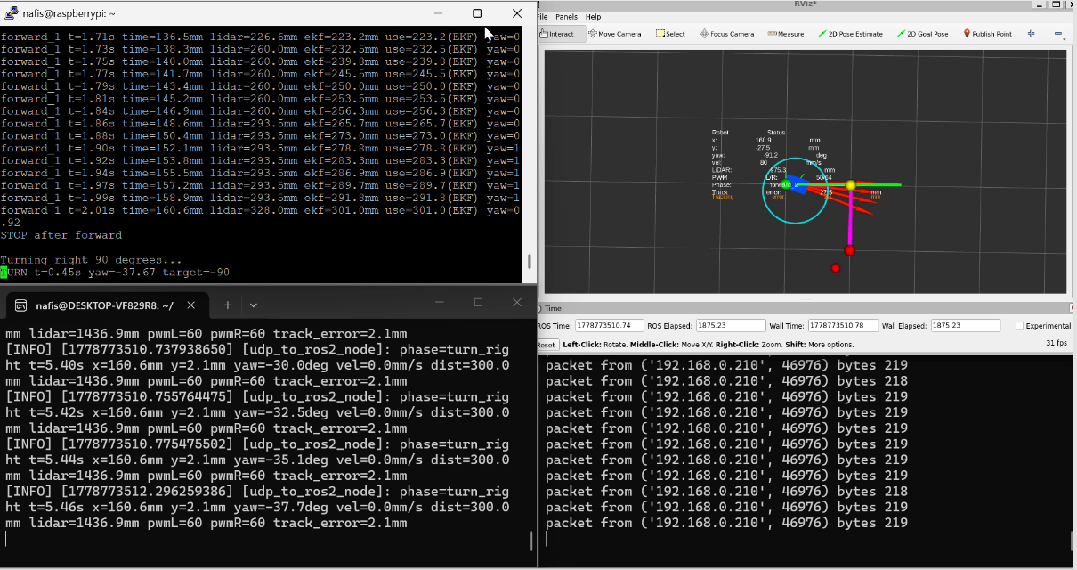
Applying EKF : Raspberry Pi using Rviz(Live Visualization)
On Ubuntu, a ROS2 node receives the UDP packets and republishes them as standard ROS2 messages (Path, Pose, Markers, TF).
RViz renders robot state, trajectory, and orientation live during operation.
Purpose: live demonstration and debugging — watching the robot move in RViz in real time.

Slide 14
RViz Data Analyzed in MATLAB
Result Table
 | Motion Phase | Target Distance | EKF Distance | Distance Error | Distance Error % | Target Yaw | Actual Yaw | Yaw Error | Yaw Error %
1) | Forward 1 | 300 mm | 300.99 mm | +0.99 mm | 0.33% | 0° | 0.92° | 0.92° | 0.92°%
2) | Right Turn | — | — | — | — | −90° | −86.45° | 3.55° | 3.94%
3) | Forward 2 | 200 mm | 201.28 mm | +1.28 mm | 0.64% | −90° | −89.57° | 0.43° | 0.48%
4) | Total Forward | 500 mm | 502.27 mm | +2.27 mm | 0.45% | — | — | — | —

Slide 15
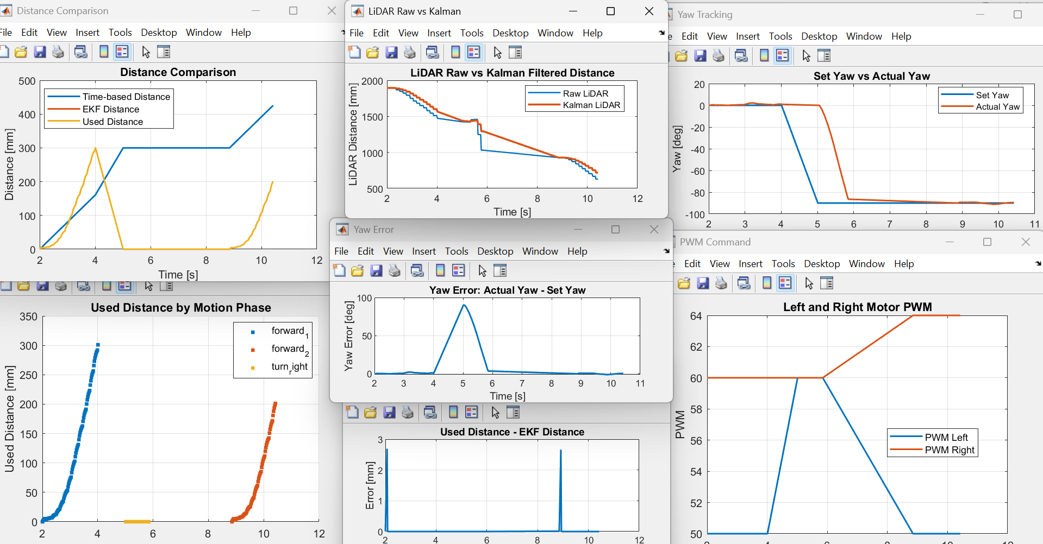
Rviz plotted Data Analyzed in MATLAB
Kalman filter reduces LiDAR noise.
Actual yaw follows the target yaw.
Yaw error peaks during turning.

Slide 16
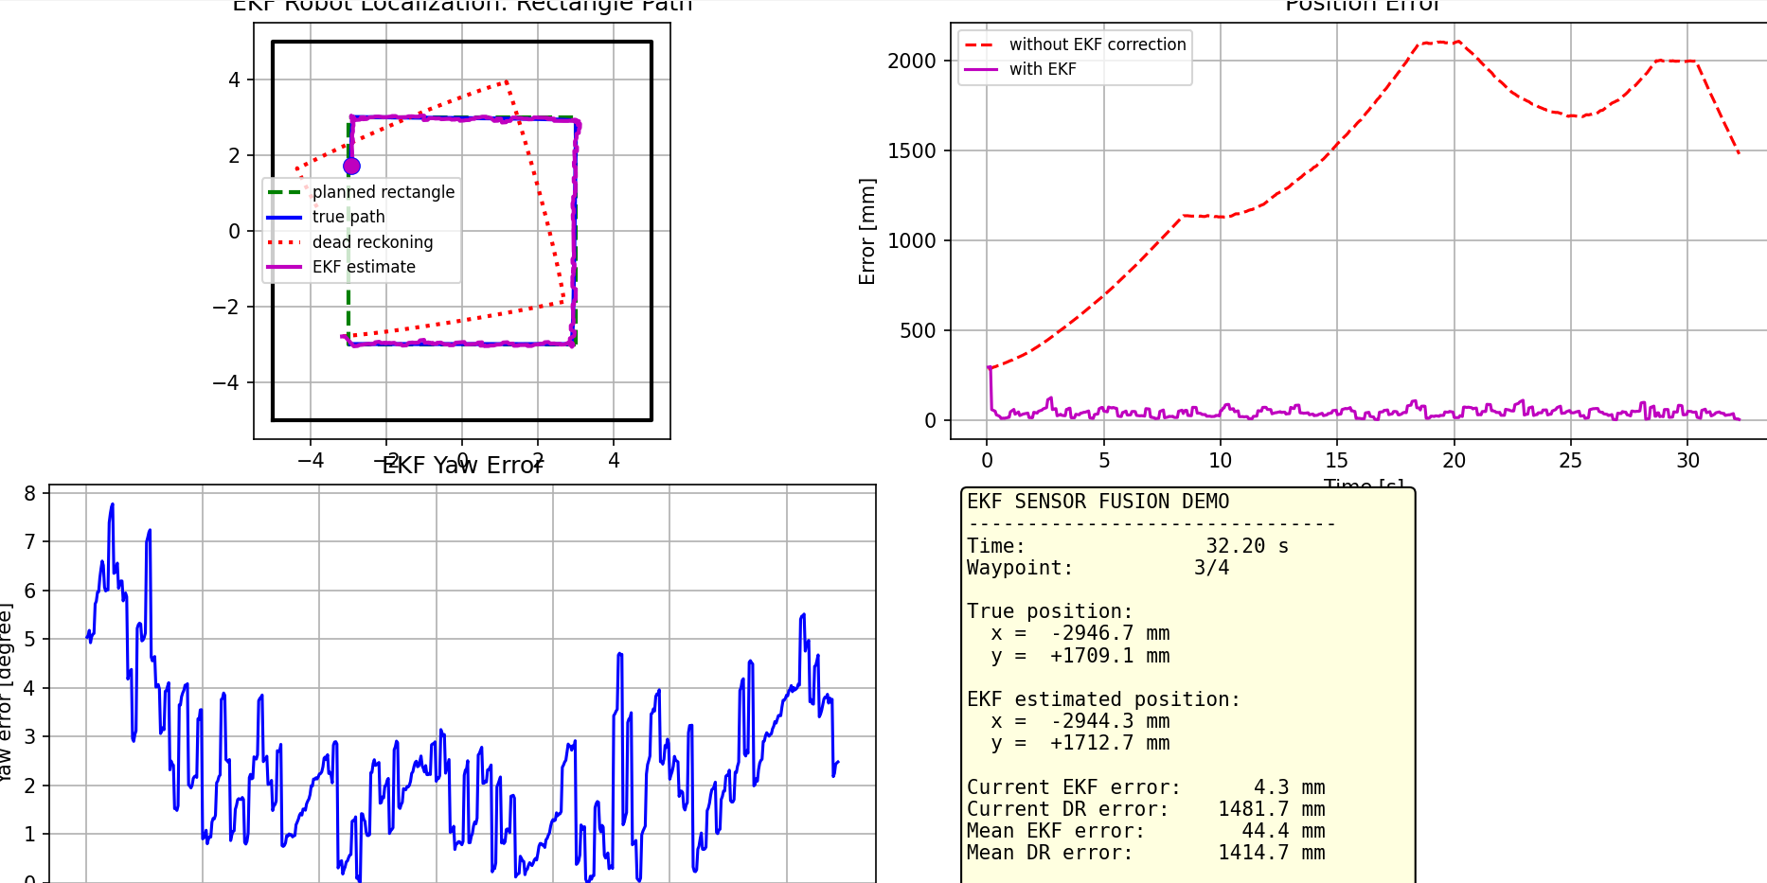
Simulation Using EKF
In Python simulator, now with the EKF enabled.
Drift is visibly suppressed; the estimated trajectory tracks the reference path cleanly.
The EKF mathematically reduces drift, as expected from theory

Slide 17
Successful LiDAR–IMU Fusion Test
Forward 1 distance error: 0.33%
Right turn yaw error: 3.94%
Forward 2 distance error: 0.64%
Forward 2 yaw error: 0.48%
Total forward distance error: 0.45%

Slide 18
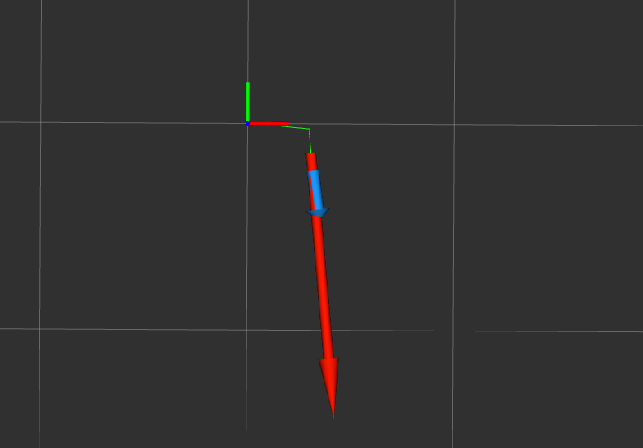
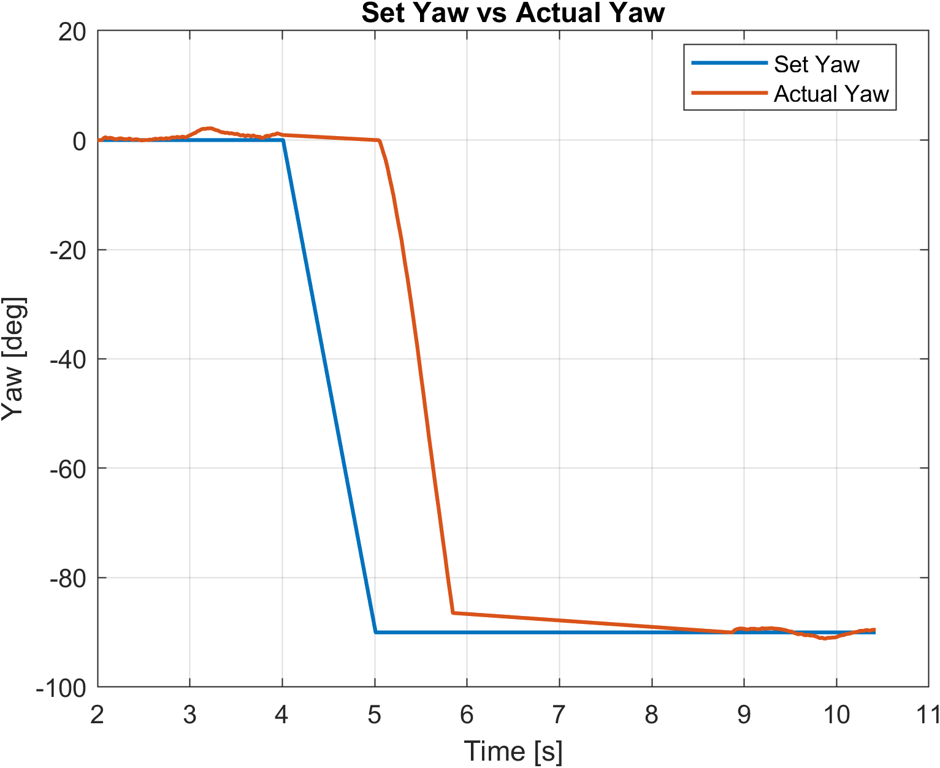
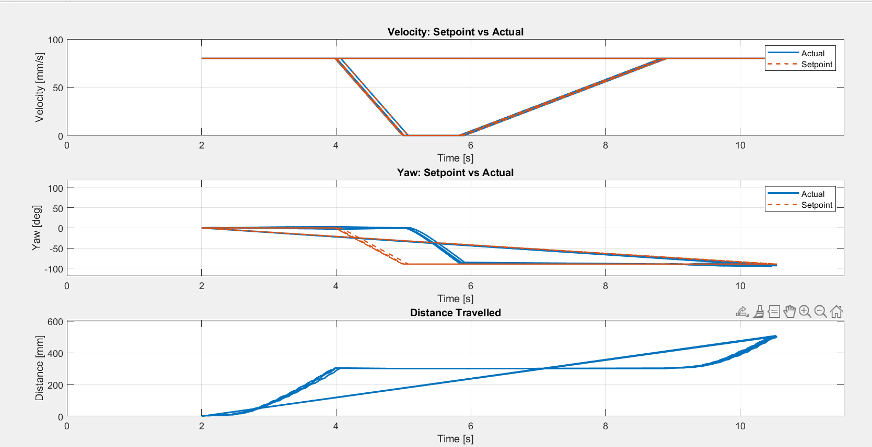
Limitation: Small Yaw Error During Sharp Turn
During the sharp right turn, yaw response has a small delay and does not reach the exact −90° target.
The robot reached about −86.45°, giving 3.55° yaw error, mainly due to wheel slip and motor imbalance.
After the turn, EKF stabilizes the robot again; in Forward 2 yaw improves to −89.57° with only 0.43° error.

Slide 19
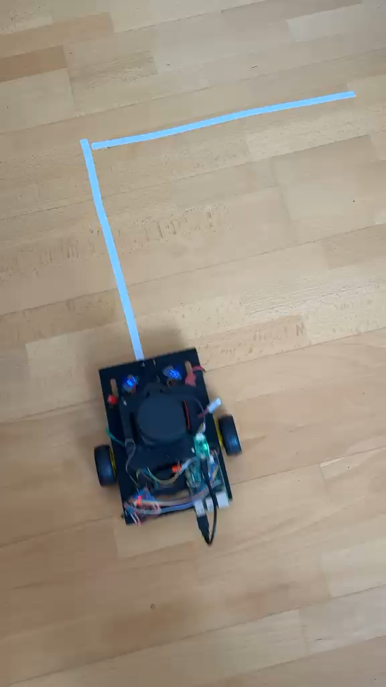
Live Car Visualization

Slide 20
Probable Solutions and Future Improvements
Wheel encoders
Closed-loop PID
A better motor driver
A stable power supply
Yaw-based turn control
Mechanical improvements
Rigid sensor mounting
Advanced LiDAR processing
A full rectangular path test
Repeated trials

Slide 21
References & Software Tools
Theory & Algorithm
R. E. Kalman, A New Approach to Linear Filtering and Prediction Problems, 1960.
G. Welch and G. Bishop, An Introduction to the Kalman Filter, 2006.
S. Thrun, W. Burgard, D. Fox, Probabilistic Robotics, MIT Press, 2005.
R. Siegwart, I. Nourbakhsh, D. Scaramuzza, Introduction to Autonomous Mobile Robots, MIT Press, 2011.
J. Borenstein and L. Feng, Measurement and Correction of Systematic Odometry Errors in Mobile Robots, IEEE, 1996.
Sensors & Hardware
6. InvenSense, MPU-6000 and MPU-6050 Product Specification, 2013.
7. Honeywell, HMC5883L 3-Axis Digital Compass IC Datasheet, 2013.
8. Raspberry Pi Foundation, Raspberry Pi Documentation.
9. L298N H-Bridge Motor Driver Datasheet / Module Documentation.
10. LiDAR Sensor Manufacturer Documentation / Datasheet.
Software & Tools
11. MATLAB, MathWorks Documentation — data logging, plotting, post-processing.
12. ROS 2 Documentation, Open Robotics — robot communication and visualisation pipeline.
13. RViz Documentation, Open Robotics — live robot/path visualisation.
14. Python Documentation — Raspberry Pi control, UDP telemetry, sensor processing.
15. Ubuntu Documentation — host-side ROS 2/RViz environment.

